Slide 1
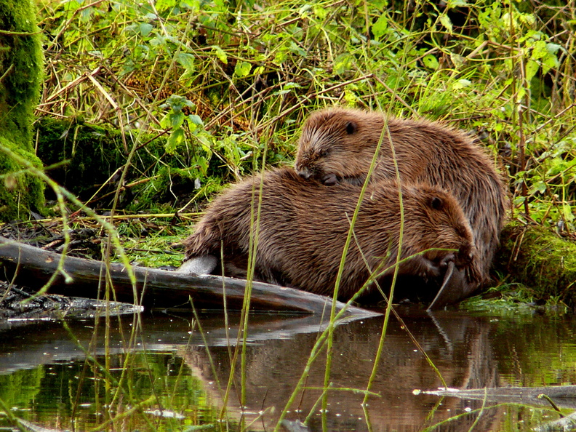
International Beaver Knowledge Hub
Marloes Leeflang
Photo: Leen Kiekboom

Slide 2
Connecting and sharing
Partners
Environment Agency
Natural England
Beaver Trust
Stowa
Dutch Mammal Society
Individual beaver experts
Vision
Gather and share valuable and reliable knowledge
focussing on Eurasian beavers
their impact on the environment
on an international level
Audience
Researchers and professionals/practicioners working with beavers

Slide 3
The Platform
Now: design platform, create content
Summer: upload content to platform
Autumn: publish and share
The hub will continue to grow and develop over time
Aim to be the go-to platform about beaver benefits and management
with sustainable coexistence in mind

Slide 4
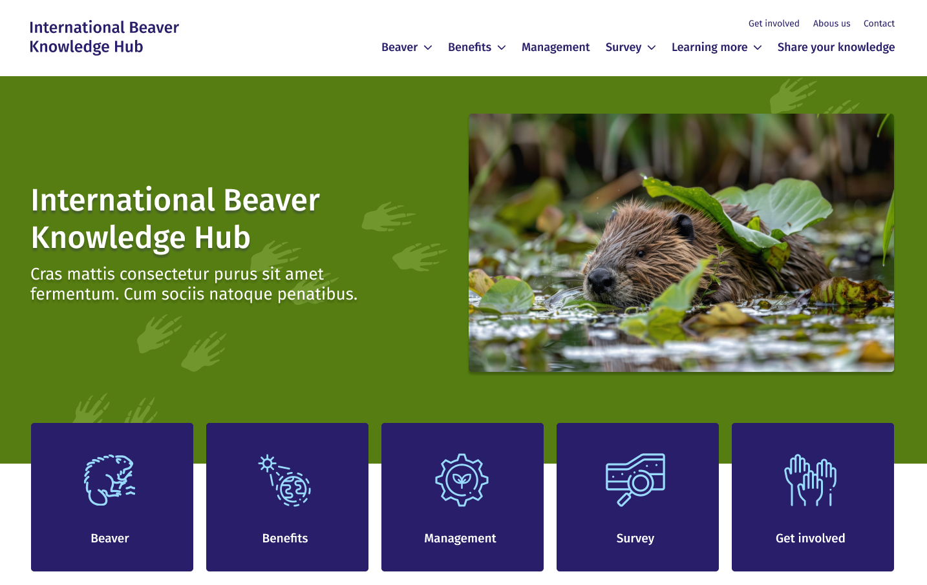
Sneak peak

Slide 5
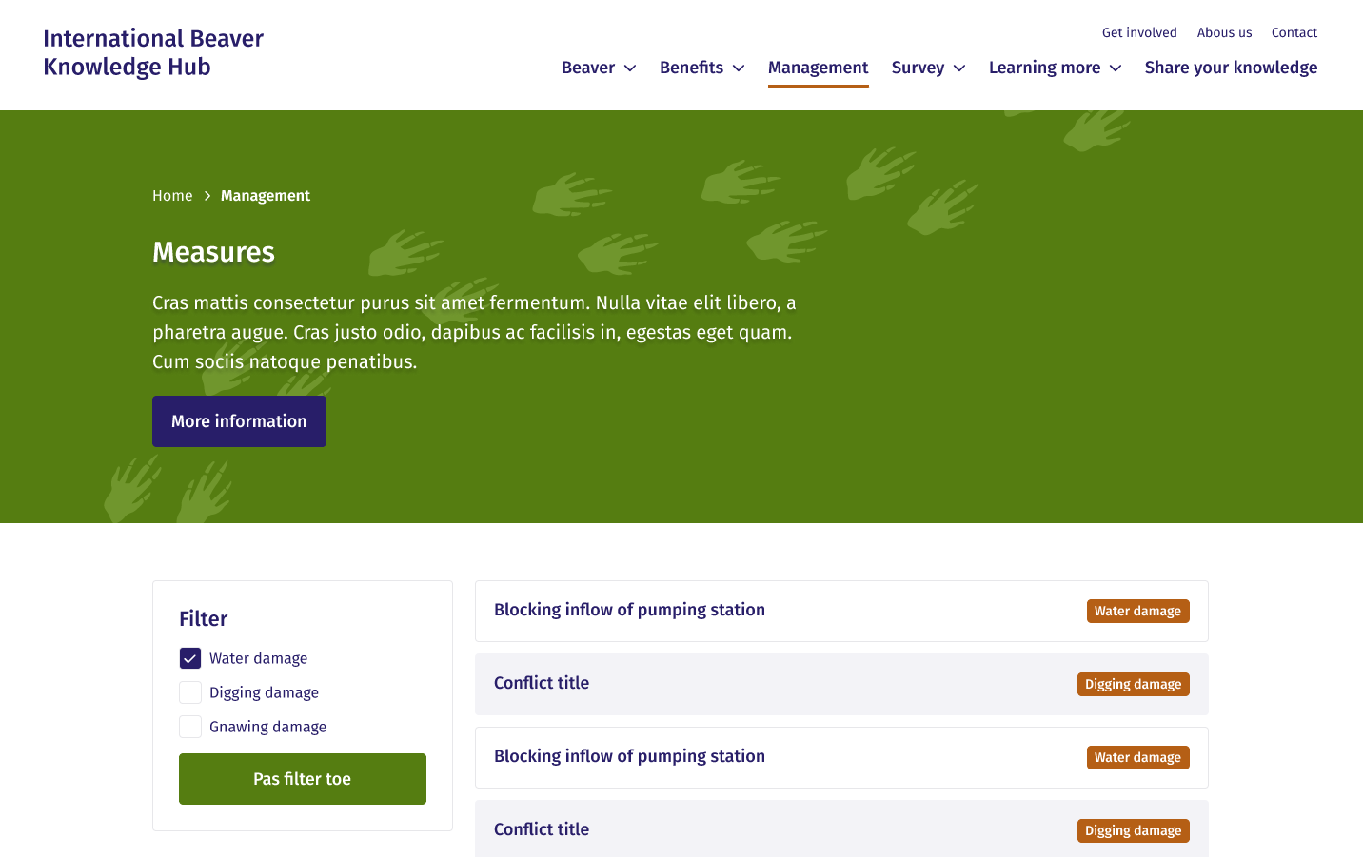
Sneak peak

Slide 6
Want to support the hub?
Contribute as a writer or editor
Contribute your local knowledge through reports
Contribute via sharing relevant weblinks
Email: marloes.leeflang@zoogdiervereniging.nl

Slide 7
Questions?
Marloes Leeflang – marloes.leeflang@zoogdiervereniging.nl
Photo: Leen Kiekboom

